Slide 1
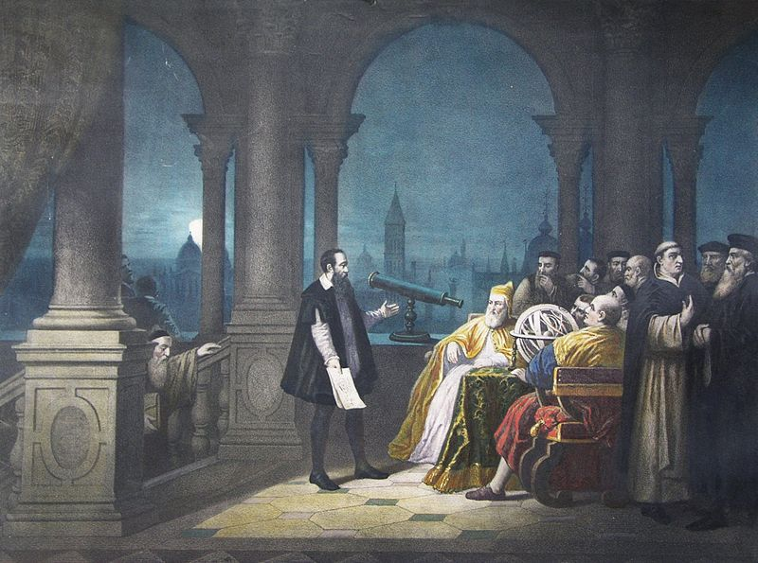
Big data camp intro
Jerry Davis 17 June 2019

Slide 2
What are we up to this week?
Monday: overview, SQL, project group formation
Tuesday: Python and Python for data analysis
Wednesday: Scraping and APIs
Thursday: Buffet of advanced topics
Friday: write “Social capital asset pricing model (SCAPM)” app for iPhone, sell to Facebook for $10B, quit grad school

Slide 3
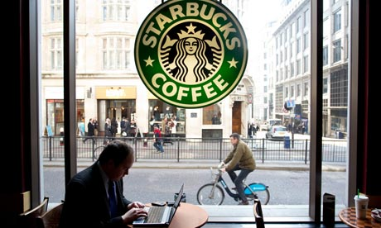
What does social life look like today?
Consultant running meeting on Google Hangouts
Real estate agent checking listings
Journalist applying for job
Student writing paper for class
Activist uploading files to Wikileaks
Professor grading papers

Slide 4
The job description for 90% of the people at the University of Michigan:
“Stare at a screen and type on a keyboard”

Slide 5
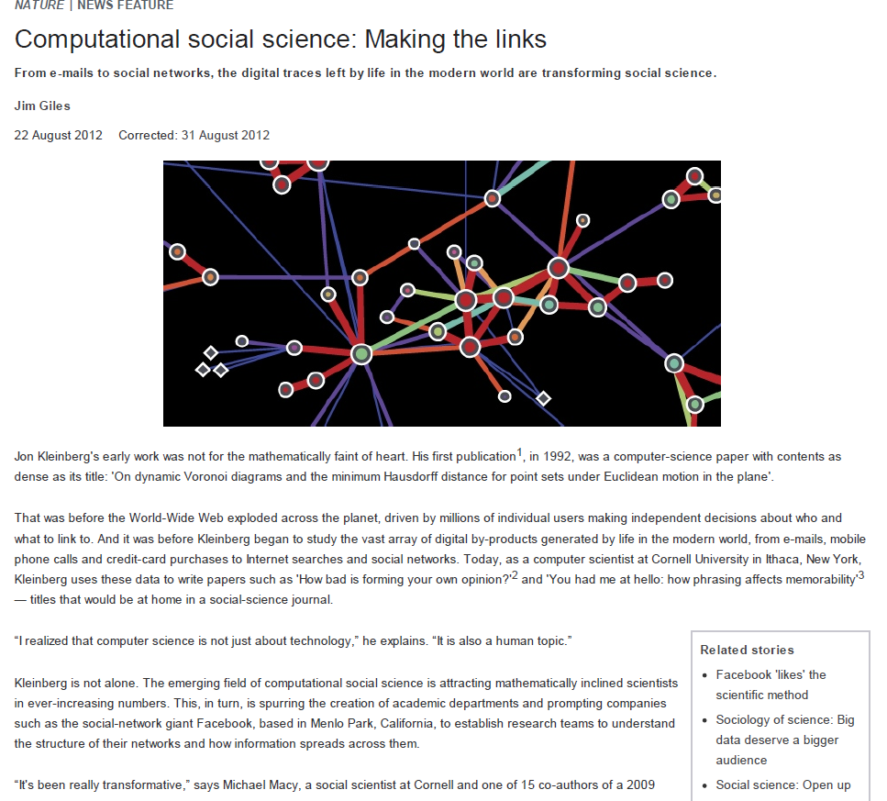

Slide 6
Thanks to ICTs, economics today is “roughly where astronomy was when the telescope was invented or where biology was when the microscope was invented.” (Robert Shiller, certified smart guy)

Slide 7
How should the pervasive “mediation” of contemporary social life affect social science?

Slide 8
Google Trends: the gateway drug for big data

Slide 9
New insights into traditional topics

Slide 10
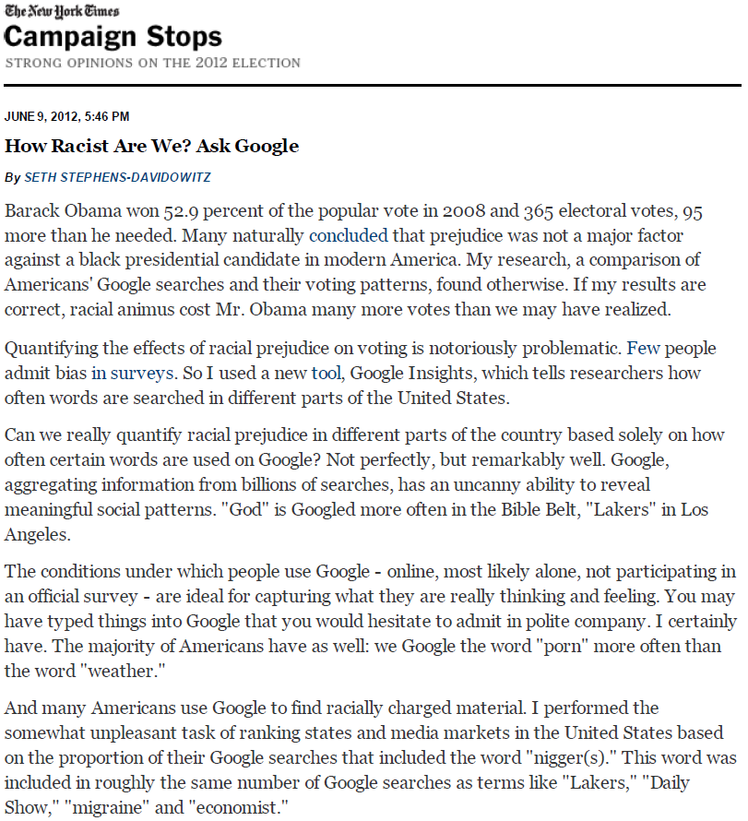
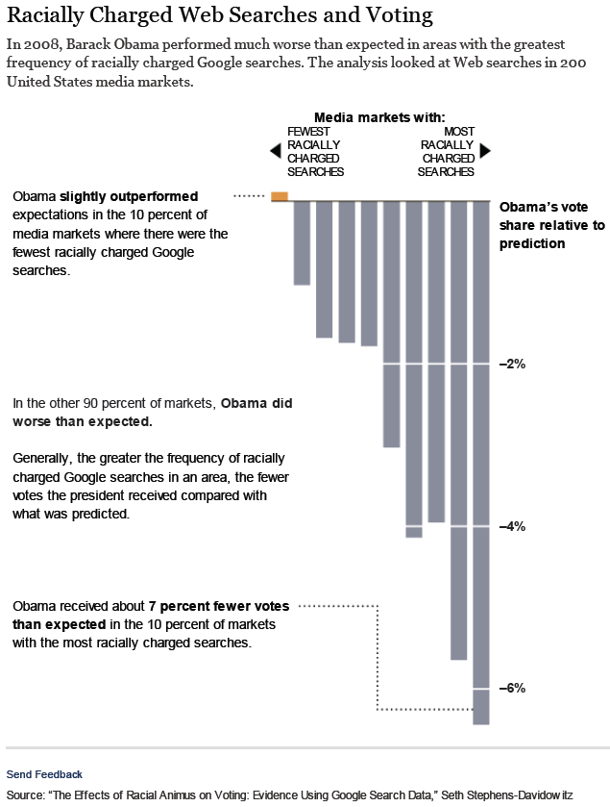
Does racism influence voting?

Slide 11
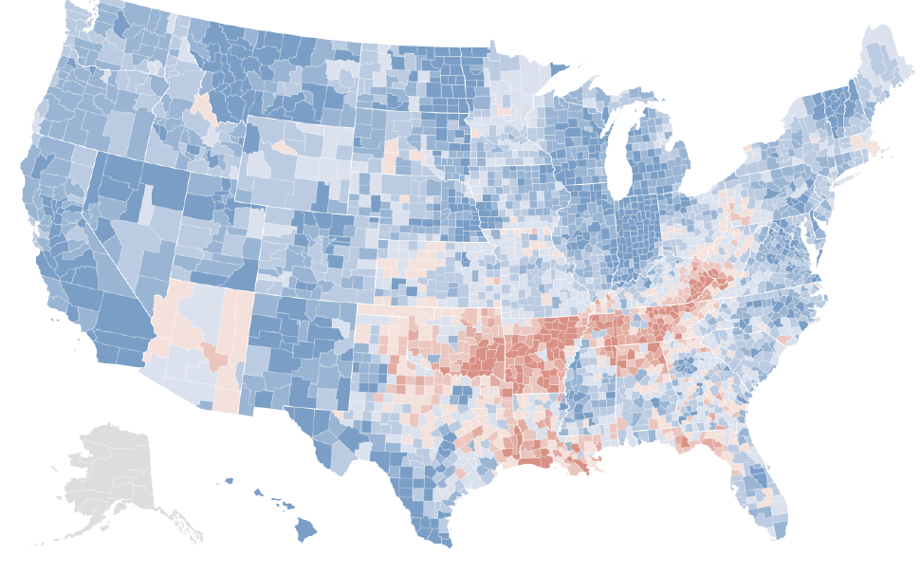
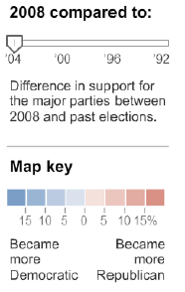
Does racism influence voting?

Slide 12
New insights into new topics

Slide 13
If only someone would come up with a way to gather horrifyingly intrusive personal information online…

Slide 15
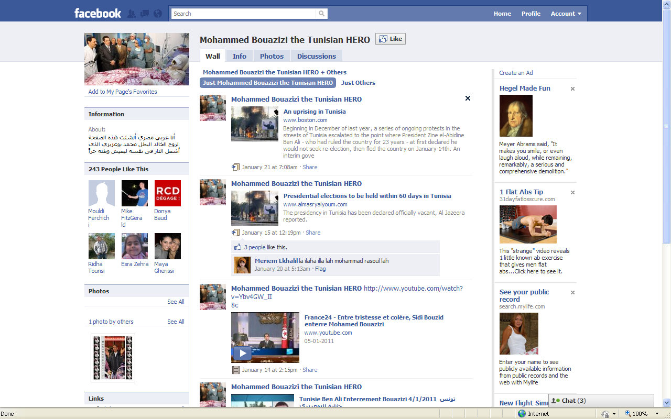
ICTs and social movements

Slide 16
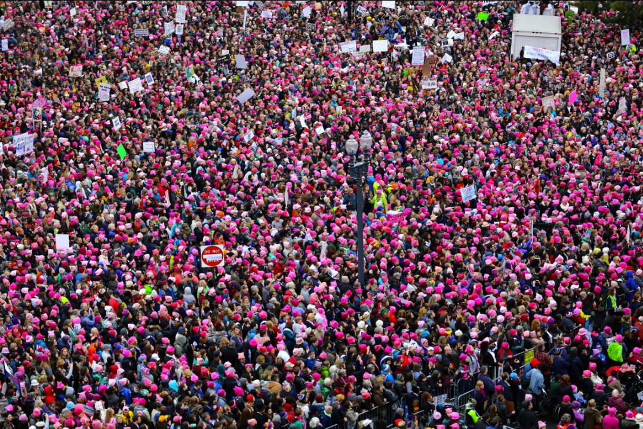
One Facebook post

Slide 17
A deep philosophical point:
A web page does not exist until you perceive it.
(Whoah)

Slide 18
How big is big data?
Visit your favorite website (e.g., www.umich.edu)
Right-click and “View page source”
Wait, what is all this stuff?
Search for http
Is there some convenient way to search through all this junk online, copy it, and drop it into a database for future use? (Will the site’s owner get mad?)
Is there an easier way to just download all this stuff in bulk?

Slide 19
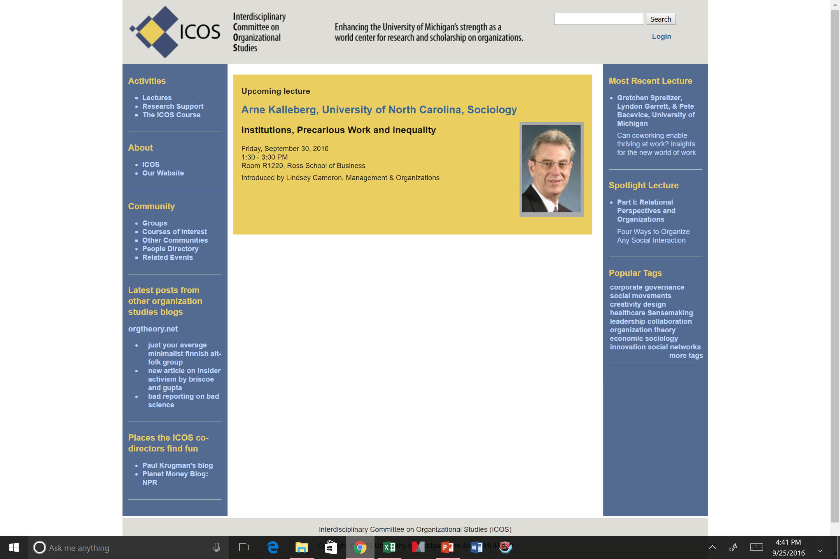

Slide 20
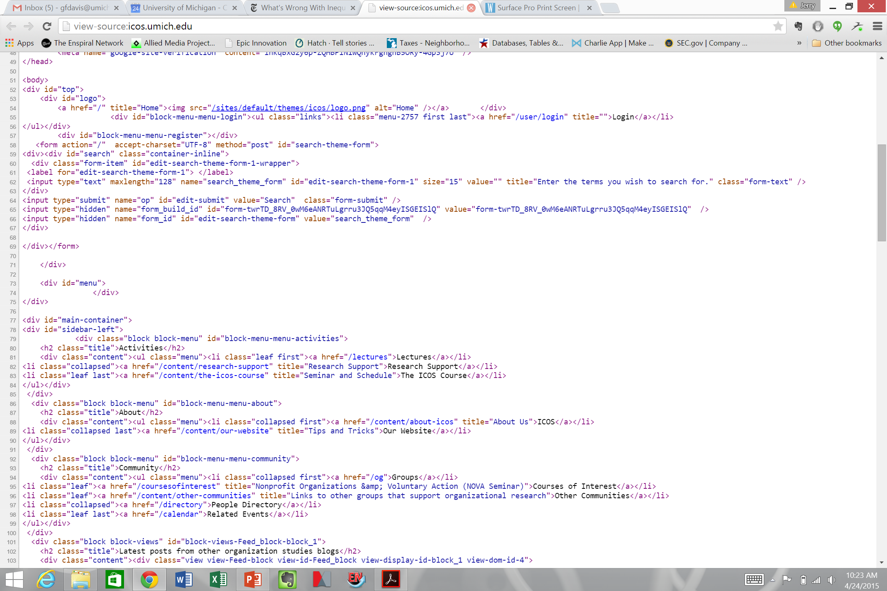

Slide 21
Some big data questions
Where do I get “big data”? Is there some secret handshake I need?
What does it look like?
How do I make gigabytes of words and numbers into something meaningful?
If I can’t learn to do everything I need about big data in a week, where can I go next?

Slide 22
A method and three tools to start
The method: learning in groups (cf. “agile software development”)
The tools:
SQL: how to manipulate those databases underlying what you see on the Web
Python: a pretty good open-source programming language
APIs: how to get them to talk to you

Slide 23
Be Not Afraid: lessons from “computer science”
Plagiarized from the estimable Prof. Brian Noble

Slide 24
We’re All Charlatans
Computer science: not a science
Few “natural laws” because it is a human construction
Exception: “This sentence is false.” (1/3 of EECS 376)
Software engineering: not an engineering discipline
Engineering: static/dynamic modeling, safety margins, etc.
Software: “Recovery-oriented computing” (1/5 of EECS 582)
A culture of decentralized collaborative tinkering
Facebook: likely the most successful company run this way

Slide 25
MOVE FAST AND BREAK THINGS (like democracy)
Facebook Rule #1

Slide 26
Don’t be afraid to make a mistake
Everyone makes mistakes!
I (Brian Noble) make programming mistakes all the time
Students who actually do things make mistakes as well
Professional staff at Facebook do too (obviously!)
Fundamental to the process
These are formal languages (vs. natural)
Mortals aren’t inherently great at this

Slide 27
Stay focused and keep shipping
Facebook Rule #2

Slide 28
Don’t Wait to Find Your Mistakes
Build a little, test a little
“You keep using that word. I do not think it means what you think it means.”
--Inigo Montoya
You have an important advantage!
CS students believe they are really good at this
But, no one is really good at this, just shades of bad

Slide 29
Done is better than perfect
Facebook Rule #3

Slide 30
Never Fly Solo
Two people per keyboard, always
Everyone is bad at this, but in different ways
Only one of you needs to see the problem
Trade hands-on-keyboard frequently
It’s tempting to let one person “do the work”
You lose much of the benefit this way
Talk about what you are doing as you do it
Forces you to reveal hidden assumptions
Catch some mistakes even before you make them

Slide 31
Fortune favors the bold
Facebook Rule #4

Slide 32
Practical tips
There are no new problems under the sun
Check Google
Ask your physical neighbors
Ask your virtual neighbors
Steal, do not invent!
Large community with a strong culture of sharing
Before writing something, see if someone else has
Keep versions of things around: your Lab Notebook
Explains how you got there
In case you have to “go backwards”
In case you accidentally delete tons of work

Slide 33
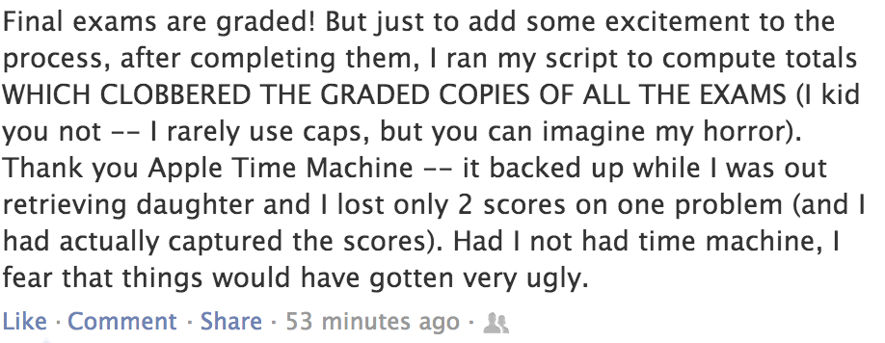
CS Professor (at another institution)

Slide 34
What would you do if you were not afraid?
Facebook Rule #5

Slide 35
A Few Caveats
You can do almost anything, but should you?
Intellectual property restrictions on code
Terms of Service restrictions on data providers
Lots of personally-identifiable information (IRB)
Computers allow you to make bigger mistakes more quickly
Get a sense for how this work is received elsewhere
Check with advisor(s)

Slide 36
The deliverable
Find one interesting true thing to say about your group’s topic by one week from Thursday afternoon, and explain how you got there

